Slide 1
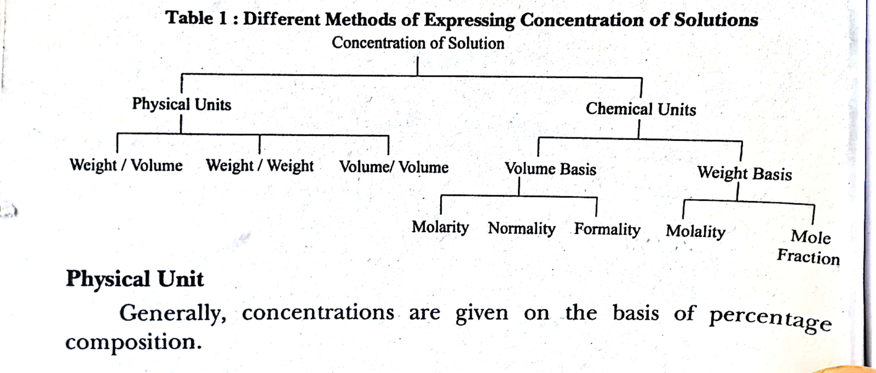
Chemical Calculations

Slide 2
Molarity
Molarity is defined as the number of moles of solute dissolved in 1dm3 of the solution.
Molarity(M) = moles of solution dissolved/ volume of the solution
Moles of solute = mass of the solute in kg/Molar mass in kg per mol

Slide 3
Formality
One formal solution (1F) is defined as the solution that contains one formula weight of the solute in 1 dm3 of the solution.
Similar to molarity,the formality F can be :
Formality = Number of formula weight/Total volume in dm3
F=[Amount of substance in g/Formula weight of substance][1/vol.in L]
F=(W2/W1)(1/V)

Slide 4
Normality
Normality (N) of the solution is defined as the number of equivalent of the solute present in 1 dm3 of the solution.
N= Number of equivalent of solute/Volume of the solution in L.
N=Amount of the solute in g/Eq.weight of the solute
N=(W2/E2)(1/V)

Slide 5
Molality
Molality(m) is defined as moles of solute associated with one kg or 1000 g of solvent.
Molality(m)=moles of solute/No of kg of solvent
M=(1000/W1)(W2/M2)
Thank You

